Slide 1
C1 What is interaction design

Slide 2
Intro
How many interactive products are there in everyday use? How usable they are?
哪些產品設計的容易使用? 為什麼? How many are actually easy, effortless, and enjoyable to use?
許多產品從engineering 觀點來看沒有問題 (提供一組功能)，可是使用者卻不了解如何操作。因設計上未考量USER。

Slide 3
互動式設計 (interaction design) 的目標: 解決以上問題，方式 –
  Bring usability into the design process (not just features).
  Develop interactive products with good usability – from users’ perspective.
本章大綱
  Difference b/t good and bad design
  Interaction design (ID) and it relation to HCI
  User experience & usability
  What & who is involved in ID
  Guidelines in ID
  Evaluate interactive products
Notes:
http://www.fastcompany.com/magazine/60/chalktalk.html

Slide 4
1.2 Good and poor design
你如何定義一個產品的可用性 (usable products)?
  Easy to learn (容易操作), effective to use (達到使用目的), and provide enjoyable user experience (使用經驗及感受).
底下將比較優良與拙劣的產品設計。藉由這些互動設計優缺點，來了解何謂可用的及不可用的。

Slide 5
上述情況的問題在哪裡？
  Take 6 steps to access a message and 5 steps to leave a message. (confusing, inefficient, difficult to use, not obvious what to do…)
難以使用、令人生氣困惑
缺乏效率，需要很多步驟來完成簡單工作。
沒有任何方法可以讓你快速知道，是否有任何留言或是到底有幾通留言，你必湏拿起聽筒去發現並且用一連串的步驟來聽取留言。
沒有明示如何使用：部分措施由系統提供，而另外一部分則需閱讀操作說明。

Slide 6
1.2.1 What to design
各種可能: There are ---
  all kinds of activities people do when interacting with the products (draw, play game ..)
    系統/產品的選擇取決於其要支援的活動
  many different types of interfaces / interactive devices (C6)
    Camera, microwave oven, washing machines…
互動設計要思考 -- 如何強化使用者與 “系統/環境/產品” 的互動，以輔助他們操作這些設備?
當考量一個設計的使用性時，要考慮哪些層面?
  Who the users are
  What activities are being carried out
  Where the interaction is taking place

Slide 7
Understanding users
有哪些關於使用者部分是可以考量的?
  What they are good and bad at What might help them with the way they currently do things
  What might provide quality user experiences

Slide 8
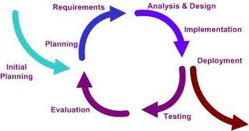
可以使用的方法
  Listen to what they want (邀請她們一起設計)
  Use “tried and tested” techniques during the design process (循環式設計)

Slide 9
1.3 What is interaction design
互動設計定義?
Designing interactive products to support people in their everyday and working lives.
Interaction designer creating user experiences that enhance and extend the way people work, communicate and interact -- Finding ways of supporting people (現在已經從 performance to experience – paradigm shift)
實務上 -- How to design user experiences (goal-directed, thoughtful 體貼)

Slide 10
互動設計師 vs. 軟體工程師比喻
Architects 建築設計師 (互動系統設計者)
Concert with the people and their interactions with each other and within the house
反之Software engineering focuses on the production of software solutions for given applications.

Slide 11
1.3.1 Interaction design的組成
Relationship between ID, HCI and other fields
Academic
disciplines
  Psychology
  Social Sciences
  Computing Sciences
  Engineering
  Ergonomics 人因工程學
  Informatics 資訊學
Design practices 設計實做
  Graphic design
  Product design
  Artist-design
  Industrial design
  Film industry
Interaction
Design
Interdisciplinary fields
HCI, Human factor, cognitive engineering/ergonomics認知工程, information systems

Slide 12
1.3.2 Who is involved in interaction design?
  互動設計師需要了解
    人對事情的反應
    人與人互動的
    情緒的作用、生理限制
    商業、技術、製造、行銷
  Multidisciplinary teams –
    Engineers, designers, programmers, psychologists, anthropologists, sociologists, artists, toy makers…
  參與的不同角色越多，越能激發創意，但溝通上也越不易 (不同部分的隔閡)

Slide 13
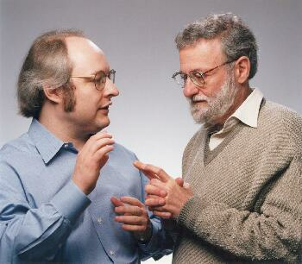
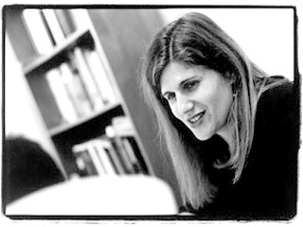

Interaction design in business
Increasing number of ID consultancies, examples of well known ones include:
  Nielsen Norman Group: “help companies enter the age of the consumer, designing human-centered products and services”
  Swim: “provides a wide range of design services, in each case targeted to address the product development needs at hand”
  IDEO: “creates products, services and environments for companies pioneering new ways to provide value to their customers”

Slide 14
1.4 The user experience
Jesse Garrett (2003) – every product that is used by someone has a user experience –
使用起來的感覺 How people feel about a product and their pleasure and satisfaction when using it, looking at it, holding, it and opening or closing it.

Slide 15
1.5 Process of interaction design?
四個基本的設計活動 (這個流程與你之前學的過程一樣嗎?)
1. 確認與建立需求 Identifying needs and establishing requirements (分析)
2.發展多個設計想法 Developing alternative designs that meet those requirements
3. 建置雛形以供評估 Building interactive versions of the designs so that they can be communicated and assessed.
4. 評估雛形使用性 Evaluating what is being built throughout the process (measure the usability)

Slide 16
以使用者為中心的設計User-centered (UC) approach
UC approach:
-- Evaluation (chapter 12-15)
-- Understand what people do 人如何與他人、資訊、科技互動。人的能力，情緒、需求、欲望、困擾。了解這些可幫助設計者選擇設計方案，並進行設計與測試 (chapter 345)
-- How an understanding of people and what they do can be translated to requirements
(chapter 10)
-- Involve users in design process (chapter 9 & 11)
Notes:
P. 17-18

Slide 17
What are the reasons of understanding users in the contexts ?
1. 不同的使用者需求不一 (個人差異: 理解能力、喜好…)
2.發覺designers對於users特性及需求的錯誤假設/認知
3. Be aware of cultural differences 了解文化差異有助於設計產品給跨國家族群
Notes:
P 18

Slide 18
Key characteristics of the ID process
1. Involve user through the process
方式: observing users, taking to them, interviewing them, testing them using performance tasks, modeling their performance, asking them to fill in questionnaires, asking them to become co-designers
2. Specific usability and user experience goals should be identified, clearly documented, and agreed upon at the beginning of the project
從一開始即共同訂出.使用性以及使用者經驗標準
3. Iteration through the four activities is inevitable. 重複process of ID 四步驟

Slide 19
1.6 Interaction design and the user experience
為清楚訂定產品設計目標(增強效率OR 帶來愉悅 )，可將之分為usability goal and user experience.
互動式設計目標可稱之為:
1. Usability goal –
    Concerned with meeting specific usability criteria (e.g. efficiency)
2. User experience goal –
  Concerned with explicating the nature of the user experience (aesthetically pleasing)
Notes:
P 16

Slide 20
1.6.1 Usability goals
使用性有以下目標 (以問題型式呈現)
1. Effective to use (effectiveness)
是否能有效完成應做的事 how good a system is at doing what it is supposed to do (選課)
要問的 Q: 系統是否能讓使用者去執行他們要做的事情
2. Efficient to use (efficiency)
系統支援使用者執行工作的方法是否有效率 (e.g. 減少操作步驟) the way a system supports users in carrying out their tasks. (選影片)
要問的 Q: 一但使用者學會操作系統，是否能達到高產出率(效率)

Slide 21
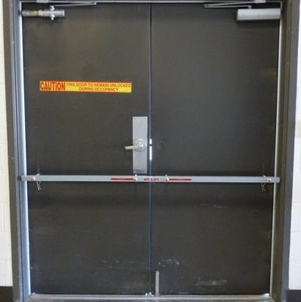
3. Safe to use (safety)
考慮外在環境, 保護使用者使免於危險 protecting the user from dangerous condition. e.g. 拆爆裂物小組，X光操作員，化學藥廠工作 –可從遠端操作
防止嚴重錯誤
回復 (undo, photoshop history)
要問的Q: 系統防止使用者發生嚴重錯誤，錯誤一但發生能夠回復嗎?

Slide 22
4. Have good utility (utility實用):
The extent to which the systems provides the right kind of functionality so that users can do what they need or want to do. 能提供使用者所需的適當功能
e.g. 繪圖軟體--不同繪圖方式, freehand OR use polygon shapes
運動手錶 (高度、體溫、氣溫、防水、羅盤)
要問的 Q: 系統能否提供適當功能讓使用者以適合方式執行工作?

Slide 23
5. Easy to learn (learnability):
How easy a system is to learn to use
使用者不喜歡花時間學習，而希望能立即上手使用
如果使用者不喜歡花長時間學習一個系統, 沒必要提供過多的功能
在某些情況中 people are prepared to spend longer learning more complex systems that provide a wider range of functionality. --- step-by-step tutorial with hands-on exercises.
要問的 Q: 學習使用一個系統 (to perform core tasks / wider set of tasks) 需要花多少時間，多容易學習?

Slide 24
6. Easy to remember how to use (memorability)
How easy a system is to remember how to use, once learned. 一旦學會了，能夠記得其操作方法，針對不常用的系統，能在短時間內回憶起如何操作 (銀行帳戶系統)
Q: 提供哪些支援來協助使用者去記住如何執行不常使用的工作 (以前WORD的履歷表及信件撰寫功能)

Slide 25
Usability criteria 使用性
-使用性目標可轉為使用性準則(usability criteria)
Specific objectives that enable the usability of a product to be assessed in terms of how it can improve a user’s performance.
Example
  time to complete a task (efficiency)
  time to learn a task (learnability)
  number of error made when carrying out a given task over time (memorability)
Notes:
準則 P25

Slide 26
1.6.2 User experience goals
與使用者經驗相關 (主觀感受) = what the interaction with the system feels like to the users，主觀經驗包括哪些?
Satisfying
Enjoyable
Engaging
Exciting
Aesthetically pleasing
Supportive of creativity
Boring
Frustrating
Annoying

Slide 27
讓USER體驗pleasurable, fun, exciting ..的要素:
  Attention, pace, play, interactivity, conscious and unconsicous control, flow (心流).
  Flow – 完全沉浸於活動中的情緒投入狀態 (e.g. 讀金庸小說)
過去HCI只重視使用性，輕忽user experience。近幾年開始注意後者 (Norman， ATM美感研究)
兩者有時無法並存 (safe, fun)

Slide 28
1.6.3 design principles
l. Visibility: 易視性
本文前面的留言機設計，The more visible functions are, the more likely users will be able to know what to do.
2. Feedback 回饋
Sending back information about what action has been done and what has been accomplished.
回饋型態: audio，tactile ，verbal, visual, combinations of these.

Slide 29
3. Constraints 限制
在特別處限制住某些使用者互動功能，例如使用grey out代表不能選取 (e.g. 大樓地下室樓梯設置小柵欄-- book)
Norman (1999): 三類限制
a. Physical: 磁片插入的方式
b. Logical: 符合人類的邏輯推理模式 disable menu options when not appropriate for the task in hand (如右圖 & 大理石留言機)
c. Cultural: 約定成俗的習慣，形狀、顏色代表的意義 e.g. smiling face,骷髏頭

Slide 30
4. Mapping 配對
Relationship between controls and their effects in the world.
(操作 = 結果) 的配對
←------ ------→

Slide 31
5. Consistency 一致性
Designing interfaces to have similar operations and use similar elements for achieving similar tasks.
使容易學習與使用(一種操作方式適用於整個介面)，但是對於複雜的介面 (多種操作) 來說，就不易達成一致性的設計
解決方式: 利用分類將同類的操作放在一起並分出subset operations. 如下一頁圖 (例如word的下拉式選單) --- 但違反了visibility原則
原則之間是有衝突的，因此要有所取捨 (tradeoff)，

Slide 32
6. affordance 支援 -- 感覺的操作方式
To give a glue = attribute of an object that allow people to know how to use it 物件外觀的特性，讓使用者看了就知道要如何操作
Perceived and real affordance – 介面上的屬於前者，門把的設計為後者 (利用一些設計來引導， 如 convention, feedback, cultural and logical constraints)
e.g. 滑鼠的外觀讓人知道要點選
門手把 – 旋轉開啟

Slide 33
Usability principles -- Nielsen
Visibility of system status
Match between system and the real world
User control and freedom
Consistency and standards
Help users recognize, diagnose, and recover from errors
Error prevention
Recognition rather than recall
Flexibility and efficiency of use
Aesthetic and minimalist design
Help and documentation

